Slide 1
IBM University Engagement Project Submission
“Exploring the Power of Agentic AI with IBM Granite and LangFlow”

Slide 2

Project Tile – Audio Signal Processing Assistant Agent
Domain of Project – Electronic and Telecommunications
Student Name | Recent Passport Photo | Email ID | Mobile number [WhatsApp]
Samruddhi Bhale |  | samruddhibhale@gmail.com | 9834570232

Slide 3
Problem Statement -
Problem Statement : Audio Signal Processing Assistant Agent
The Challenge Audio signal processing circuits such as amplifiers, filters, and preamplifiers are widely used in communication systems and consumer electronics. Students and engineers often face problems like noise, distortion, grounding issues, and incorrect filter configurations. Finding the correct solution from different technical resources is difficult and time-consuming
The Objective
Build an AI-powered Audio Signal Processing Assistant Agent that helps users understand, troubleshoot, and improve audio signal processing circuits. The solution should: Intelligent Query Understanding – Understand user questions related to audio circuits and signal processing. Troubleshooting Support – Identify issues like noise, distortion, grounding problems, and provide step-by-step solutions. Circuit Design Recommendations – Suggest improvements for amplifiers, filters, and signal conditioning circuits. Knowledge Retrieval (RAG) – Retrieve relevant information from electronics and signal processing documents to provide accurate answers.

Slide 4
Proposed Solution -
Proposed Solution: AI-Powered Audio Signal Processing Assistant Agent The proposed solution is an AI-powered Audio Signal Processing Assistant Agent developed using IBM LangFlow, IBM watsonx.ai, and Granite Models. It helps students and engineers understand audio signal processing concepts, troubleshoot circuit issues, and improve circuit performance through an intelligent conversational interface. The system uses a Retrieval-Augmented Generation (RAG) pipeline to retrieve accurate information from electronics textbooks, technical manuals, and signal processing documents. This enables the assistant to provide reliable explanations and recommendations. The system consists of four key modules: Intelligent Query Understanding Agent – Understands user questions related to audio circuits, amplifiers, filters, and signal processing concepts. Troubleshooting Support Agent – Detects common issues such as noise, distortion, grounding problems, and signal attenuation, then provides step-by-step debugging guidance. Circuit Design Recommendation Agent – Suggests improvements for amplifiers, filters, and signal conditioning circuits to achieve better performance. Knowledge Retrieval Agent – Retrieves relevant technical information from electronics and signal processing documents using the RAG approach to support accurate responses. The solution also includes a user-friendly dashboard (built using Streamlit or React) where users can ask questions, view troubleshooting steps, and access design recommendations in an easy-to-understand format. IBM LangFlow is used to create the AI workflow, watsonx.ai provides the AI models and embeddings, and Granite Models generate accurate explanations and recommendations. Overall, this solution serves as an intelligent learning and troubleshooting assistant, helping users solve audio circuit problems faster and improve their understanding of audio signal processing.

Slide 5
Technology Used
LangFlow Platform – Used to design and orchestrate the AI workflow visually, connecting multiple AI agents for audio signal processing tasks. IBM Granite Model (e.g., ibm-granite-3-2-8b) – Used for natural language understanding, answering user queries, troubleshooting audio circuits, and explaining signal processing concepts. IBM Cloud – Provides a secure, reliable, and scalable platform for deploying and managing the Audio Signal Processing Assistant. RAG (Retrieval-Augmented Generation) – Retrieves relevant information from electronics books, audio signal processing documents, and technical manuals before generating accurate AI responses. IBM watsonx.ai – Used for AI model deployment, embeddings, prompt engineering, and AI governance. Vector Database (FAISS/Chroma) – Stores and retrieves electronics and audio signal processing knowledge efficiently for RAG-based responses.

Slide 6
Langflow component Used -
1) Chat Input – Interface where users enter their queries related to audio signal processing, circuit design, or troubleshooting (text/voice). 2) IBM watsonx AI Agent – Processes user queries using IBM Granite Models and generates intelligent responses for audio signal processing concepts and circuit issues. 3) Name of IBM Granite Model – Granite-3.2-8B-Instruct – Used for explaining concepts, troubleshooting audio circuits, and providing design recommendations. 4) Chat Output – Displays AI-generated responses such as troubleshooting steps, circuit explanations, design suggestions, and signal processing guidance. 5) File Component – Stores and retrieves electronics documents, audio signal processing notes, technical manuals, and circuit references for RAG-based knowledge retrieval. 6) Prompt Template Component – Creates structured prompts to ensure the AI provides accurate, relevant, and consistent answers for audio signal processing queries.

Slide 7
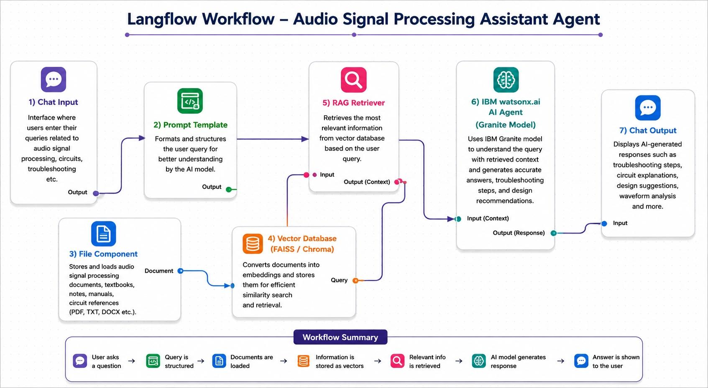
Langflow workflow -

Slide 8
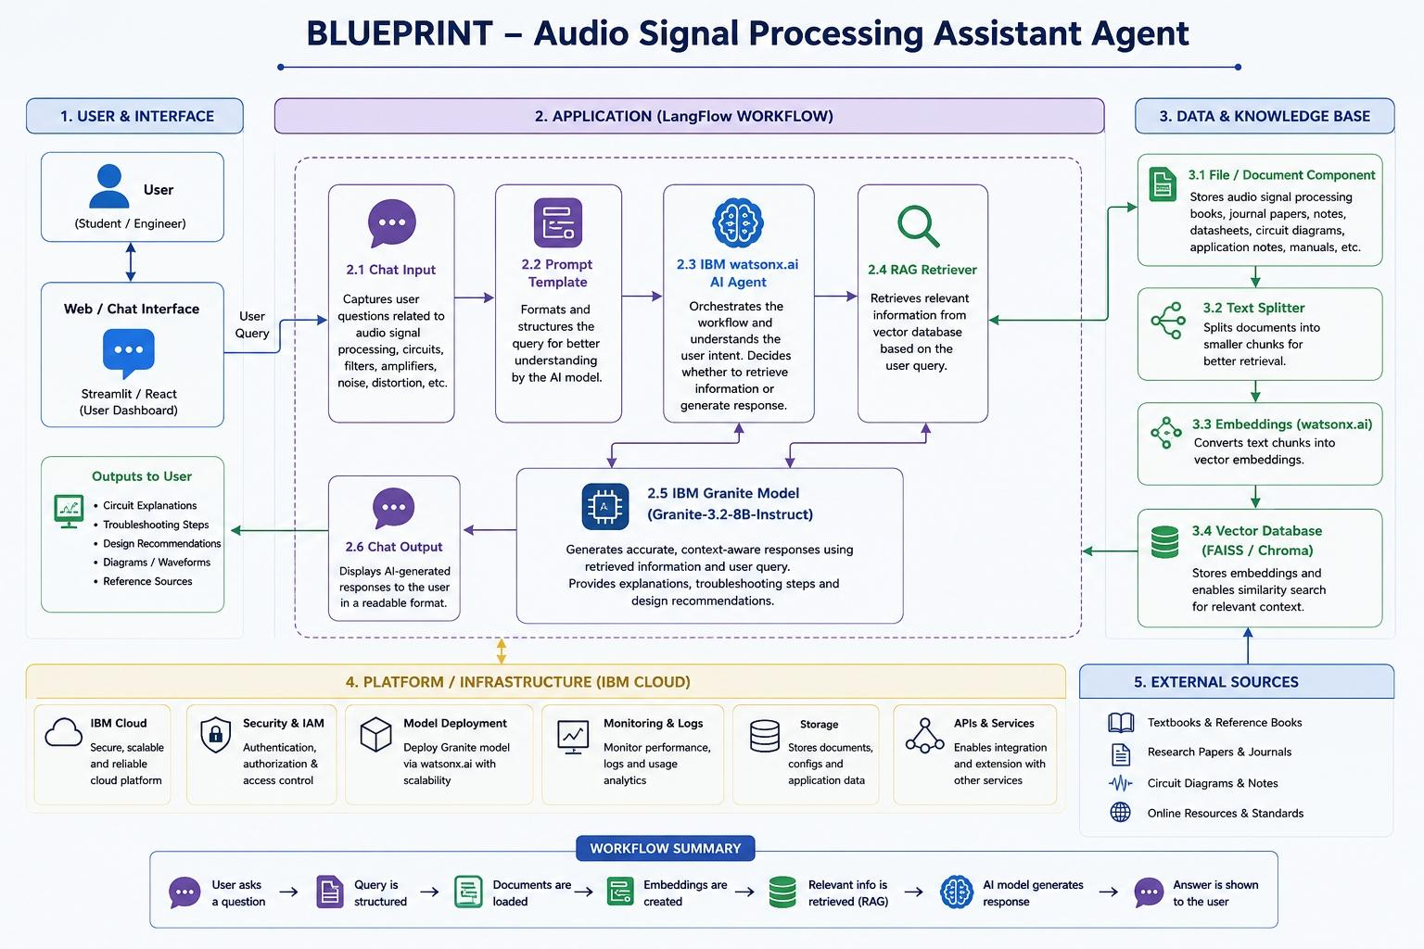
Architecture blueprint

Slide 9
Role of Agentic AI in the solution
Role of Agentic AI in Audio Signal Processing Assistant Agent Agentic AI enables the Audio Signal Processing Assistant Agent to function as an intelligent, autonomous system rather than a simple chatbot. Using IBM watsonx.ai and IBM Granite Models, it understands user queries, retrieves relevant technical information, and provides accurate troubleshooting guidance. Each AI agent performs a specific task, such as understanding audio signal processing concepts, retrieving information from technical documents, analyzing circuit problems, and recommending design improvements. These agents work together as a multi-agent system to deliver reliable and context-aware responses. The system can identify common issues like noise, distortion, grounding problems, and signal attenuation, then suggest step-by-step solutions. It also recommends suitable amplifiers, filters, and signal conditioning techniques based on user requirements. Additionally, Agentic AI continuously adapts to user queries by retrieving updated information through RAG (Retrieval-Augmented Generation), ensuring accurate and trustworthy responses. Overall, Agentic AI makes the system intelligent, interactive, and efficient, acting as a smart technical assistant that helps students and engineers understand, troubleshoot, and improve audio signal processing systems.

Slide 10
Novelty and Uniqueness
The proposed Audio Signal Processing Assistant Agent stands out by combining Agentic AI, Retrieval-Augmented Generation (RAG), and intelligent troubleshooting into a single smart assistant for audio signal processing. Multi-Agent Intelligence – Multiple AI agents collaborate to understand user queries, retrieve technical information, analyze circuit issues, and provide accurate solutions. RAG-Based Knowledge Retrieval – Retrieves real-time information from electronics textbooks, audio signal processing documents, and technical manuals to generate reliable and context-aware responses. Intelligent Circuit Troubleshooting – Detects common issues such as noise, distortion, grounding problems, and signal attenuation, then suggests step-by-step solutions. Design Recommendation System – Provides recommendations for amplifiers, filters, preamplifiers, and signal conditioning circuits to improve performance. Real-Time Technical Guidance – Delivers instant explanations, troubleshooting support, and design suggestions through a conversational AI interface. Scalable & Enterprise-Ready – Built on IBM watsonx.ai, IBM Granite Models, and LangFlow, ensuring security, scalability, and reliable AI-powered assistance. This makes the solution an intelligent, context-aware, and proactive Audio Signal Processing Assistant rather than a simple chatbot or static knowledge system.

Slide 11
Git Hub Link
Please create public github repository (Enable Add README button while creating repository) with format –
Please test and Paste the working Github URL –
Make sure you have Uploaded following three files into your github repository 1) app.json file , 2) yourproblemstatement.pdf file 3) your projectpresntation.pptx file 4)any other files
Link:
·
·https://github.com/samruddhibhale-alt/Audio-Signal-Processing-Assistant-Agent/upload
·

Slide 12
Future Scope
1. AI-Based Voice Assistant Integration The system can be enhanced with a voice-enabled assistant, allowing users to ask questions and receive troubleshooting guidance through voice commands. This will improve accessibility and provide a hands-free user experience. 2. Real-Time Audio Analysis & IoT Integration In the future, the assistant can be integrated with IoT-based audio devices and sensors to analyze live audio signals, detect faults automatically, and provide instant recommendations for improving audio quality and circuit performance. 3. Advanced Circuit Simulation Support The system can be connected with circuit simulation tools to test amplifier and filter designs, analyze signal behavior, and suggest optimizations before hardware implementation.
·
·
·

Slide 13
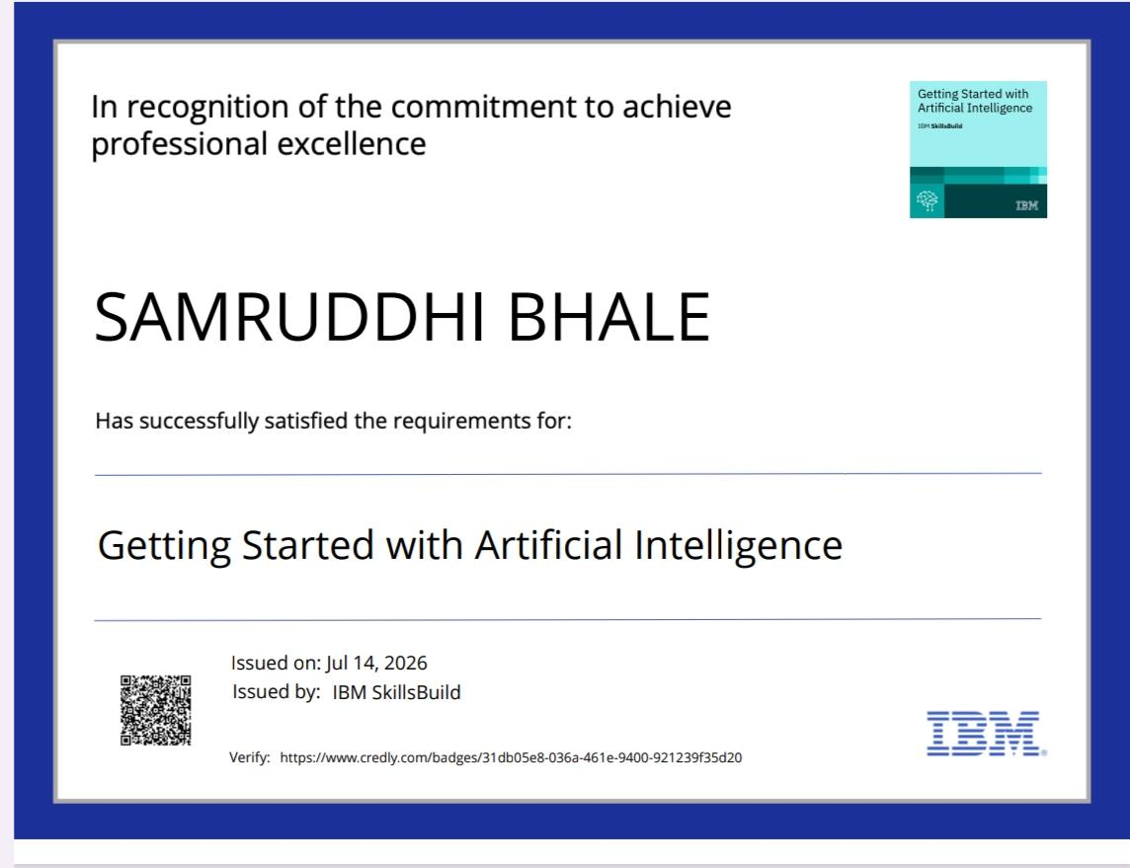
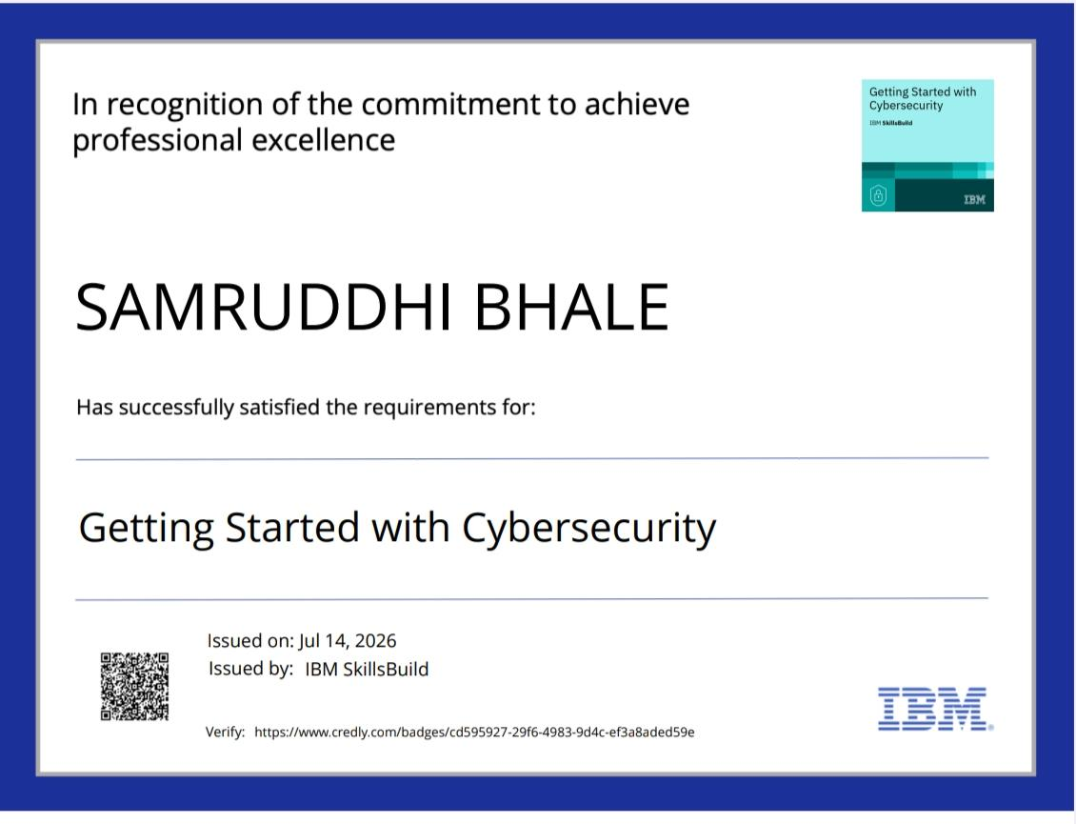
Certificates Earned:
Please add your credly certificate

Slide 14
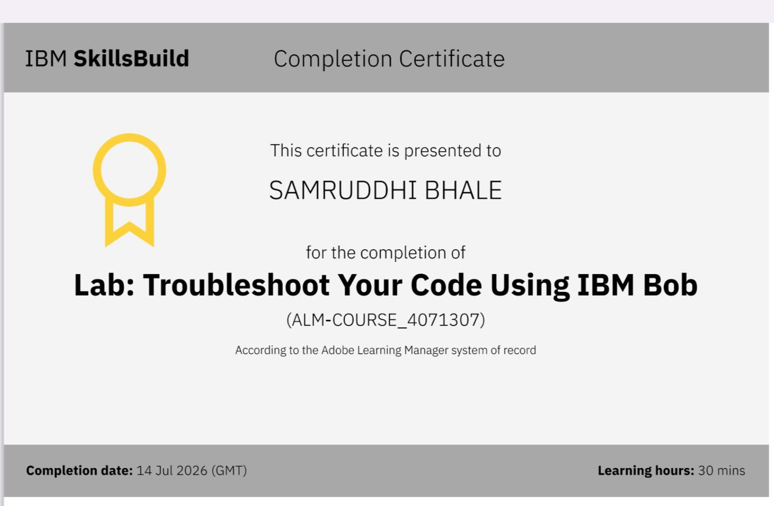
Certificates Earned:​
Add your IBM BOB Certificate

Slide 15


